Slide 1


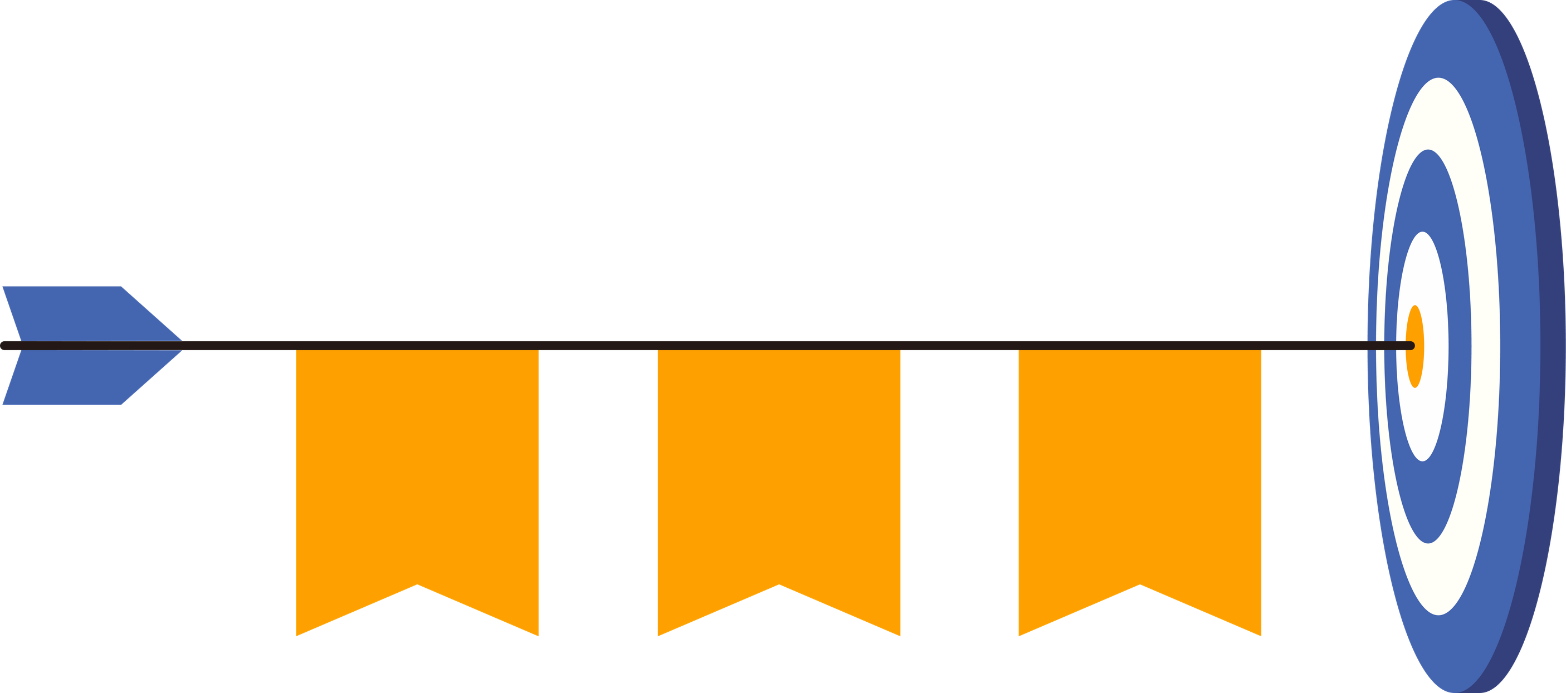




Phase 1
Phase 2
Phase 3
India’s
1960 - 1990
1990 - 2000
2000 - 2024
Exchange Rate Volatility
RBI based study
RAVISH BENIWAL & KRISHNA CHARAN

Slide 2
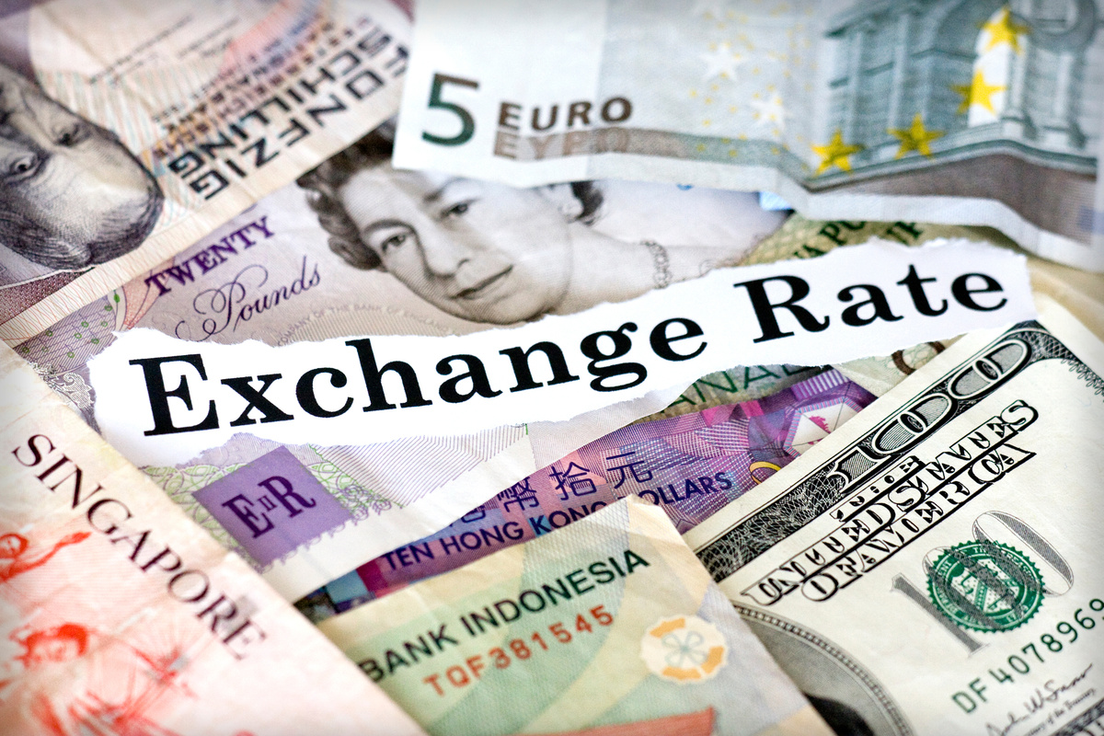


What is Exchange Rate Volatility?
Exchange rate volatility refers to how much and how frequently a currency’s value changes against another currency (for us, INR vs USD).
Our main factors to Analyse Exchange rate
01
Inflation Rate
02
GDP Growth Rate
Trade Deficit
03
(Import - Export)

Slide 3
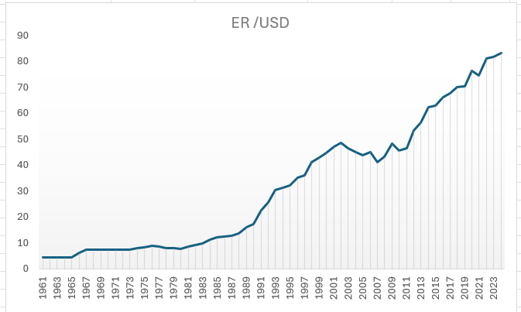


GDP increase (8-9%) in India
Boom in IT Sector
US economy faced Iraq war in 2006

Slide 4
Understanding three phases
Phase 1
Phase 2
Subscribe
Phase 3
Fixed / heavily controlled exchange rate period
Transition + Liberalisation period
Market–driven, globally connected period
1960 - 1991
1991 - 2000
2000 - 2024
Exchange rate is now flexible and reacts to global shocks.
Large swings during events like 2008 crisis, 2020 COVID shock.
Result: This period shows the highest volatility because the rupee is now mostly market determined and sensitive to global risk sentiment.
Capital flows were restricted.
Foreign trade controls were strong.
Exchange rate movement was small because RBI managed it directly.
Balance of Payments crisis in 1991 forced macro reforms.
Foreign trade, capital flows and investments started opening up gradually.
Result: Volatility increased, but market depth was still developing. This period shows “adjustment volatility”
Result: Fixed exchange rate was seen due to control of currency

Slide 5
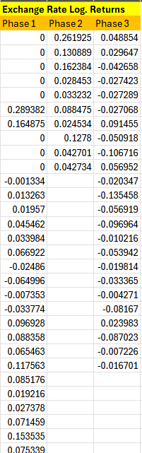
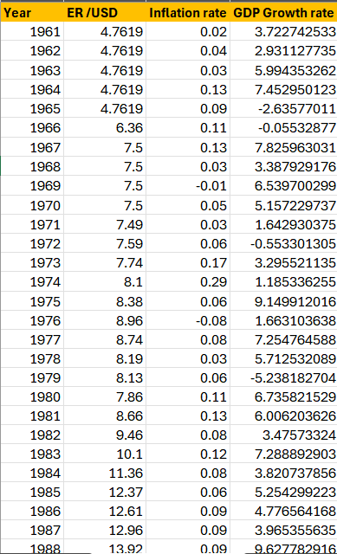

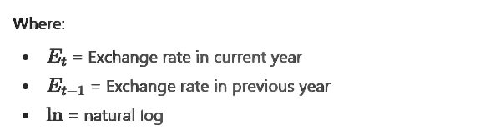

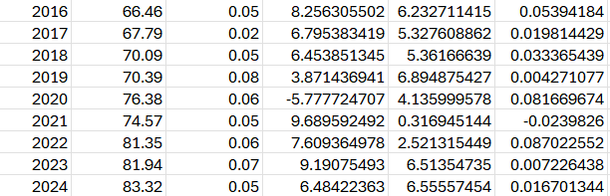
Log-Return Formula (Used to Measure Volatility).
Use exchange rate log. returns for ANOVA analyses.
Meet statistical assumptions better
Provide meaningful economic insights about volatility

Slide 6
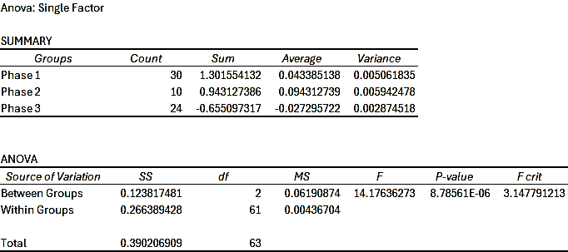

Exchange rate log. returns Anova Analysis
Reject the Null Hypothesis (H₀).
There is a significant difference in the mean exchange rate log-returns among the three phases:
Exchange rate changed especially after liberalization (1991), and again in the post-2000 globalized phase.
Phase 2 shows the highest average return, suggesting a more volatile or higher growth
Phase 3’s negative mean hints at stabilization trends in more recent years.

Slide 7
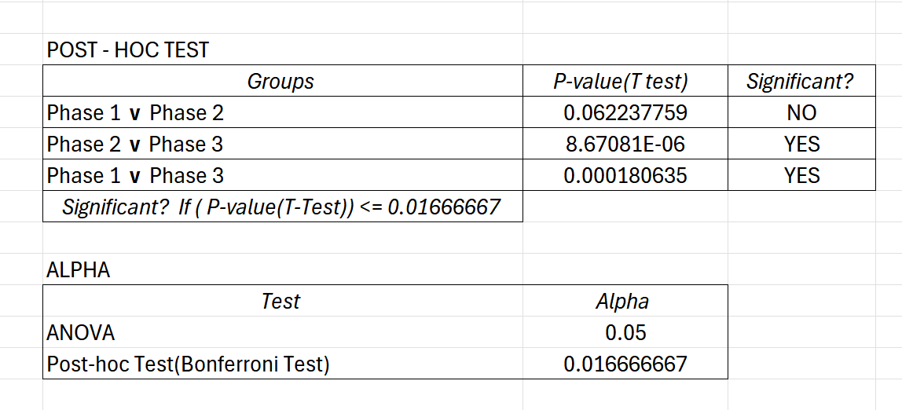
Exchange rate Bonferroni Test
The Bonferroni test (α = 0.0167) shows that there is no significant difference between Phase 1 (1947–1990) and Phase 2 (1991–2000).
However, significant differences are found between Phase 2 and Phase 3, and between Phase 1 and Phase 3.
This indicates that the exchange rate behavior or volatility changed notably after 2000, suggesting a structural shift in the exchange rate system—possibly due to deeper market liberalization, global integration, or policy reforms in the 2000s.

Slide 8
Analysing Different Factors
Inflation Rate
GDP Growth Rate of India
Trade Deficit
Higher inflation in India compared to other countries reduces the rupee's purchasing power, making exports less competitive. This decreases demand for the rupee. Central banks may also raise interest rates to combat inflation
When a country’s GDP growth rate increases, its economy becomes stronger and attracts more foreign investment. This raises the demand for its currency, so the exchange rate improves.
A trade deficit happens when a country buys more stuff from other countries (imports) than it sells to them (exports).
Exchange Rate

Slide 9


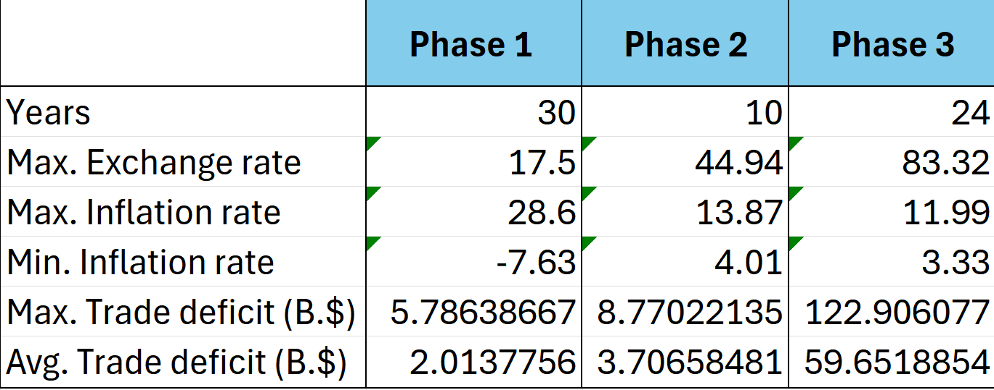
STATISTICS and Analysis
1974
Global Oil Crisis in 1973
Agriculture Shortage

Slide 10
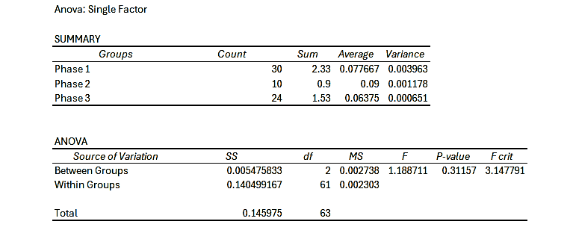
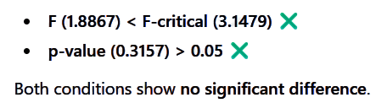
ANOVA : Inflation Rate across Exchange Rate phases
Failed to Reject the Null Hypothesis (H₀).
In Phase 2 (1991–2000), inflation slightly increased alongside exchange rate volatility — likely due to economic liberalization and price adjustments.
Inflation rate remained relatively stable and did not significantly influence exchange rate fluctuations

Slide 11
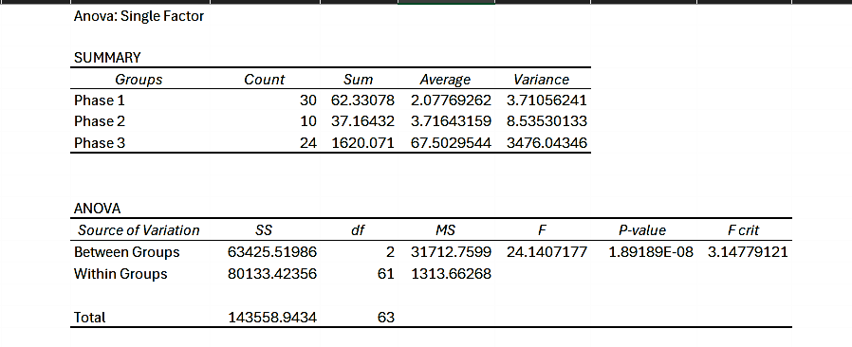
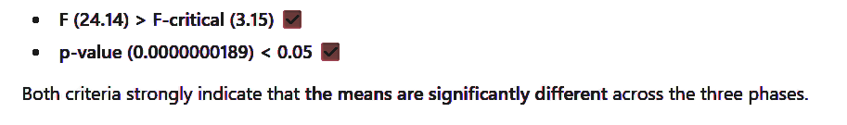
ANOVA : Trade Deficit across Exchange Rate phases
Reject the Null Hypothesis (H₀).
Phase 1 : Low deficits during a closed, regulated economy.
Phase 2 : Deficit increased after liberalization due to higher imports.
Phase 3 : Massive deficit growth during globalization and rising energy, capital, and tech imports.

Slide 12
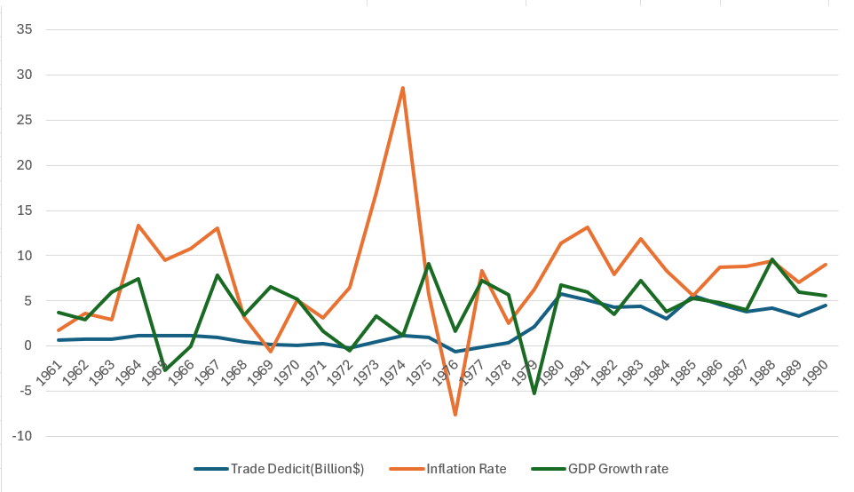

Phase 1
India - Pak war (1965) increase defence spendings
Continious Drought in 1965 - 1966 leads to spike food prices

Slide 13
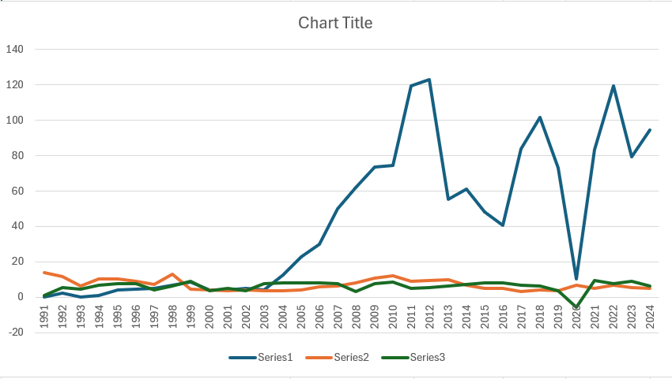
Phase 2 & 3

Slide 14
Thank You
ধন্যবাদ

